Slide 1
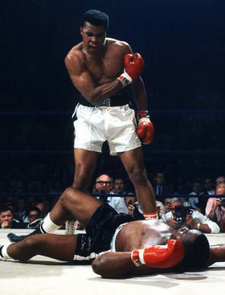
KO your MVC
Keith Burnell
Senior Software Engineer
Email: kburnell@skylinetechnologies.com
Twitter: keburnell
Blog: www.DotNetDevDude.com

Slide 2
Little about me
Senior Software Engineer at Skyline Technologies
Born and raised in Green Bay, WI
Been developing software for ~15 years
Primary focus on the Microsoft stack.
Spend majority of time developing Web *stuff*.
Consulting for last 10 years.
President of Fox Valley .NET UG.
INETA Speaker.
Blogger (DotNetDevDude.com)
Twitterer (@keburnell)
@keburnell ∙ DotNetDevDude.com
Notes:
Scrum most popular.

Slide 3
What’s on Tap
What is Knockout?
What does Knockout get me?
How do I use Knockout?
How do I make Knockout and ASP.NET MVC be BFF’s?
@keburnell ∙ DotNetDevDude.com
Notes:
Scrum most popular.

Slide 4

Knockout IS NOT a replacement for jQuery, CoffeeScript, etc.
@keburnell ∙ DotNetDevDude.com
Notes:
Scrum most popular.

Slide 5
Knockout
MVVM for HTML and JavaScript
Open source (available on GitHub)
Has an active and supportive community
With the release of VS11 it will be officially supported by Microsoft!
@keburnell ∙ DotNetDevDude.com
Notes:
Scrum most popular.

Slide 6
MVVM in JavaScript
View
HTML + declarative bindings
Browser
Automatic
ViewModel
JavaScript + observables
Ajax / form posts
“Model”
Server
Any server-side technology
@keburnell ∙ DotNetDevDude.com
Notes:
Scrum most popular.

Slide 7
What do I get by using Knockout?
Declarative bindings
Automatic UI refresh
Dependent properties
Templating
@keburnell ∙ DotNetDevDude.com
Notes:
Scrum most popular.

Slide 8

Quick and eazy example of Knockout can do
@keburnell ∙ DotNetDevDude.com
Notes:
Scrum most popular.

Slide 9

Observables
@keburnell ∙ DotNetDevDude.com
Notes:
Scrum most popular.

Slide 10
Types of Observables
Observable
Observable Arrays
Dependent or Computer Observables
@keburnell ∙ DotNetDevDude.com
Notes:
Scrum most popular.

Slide 11
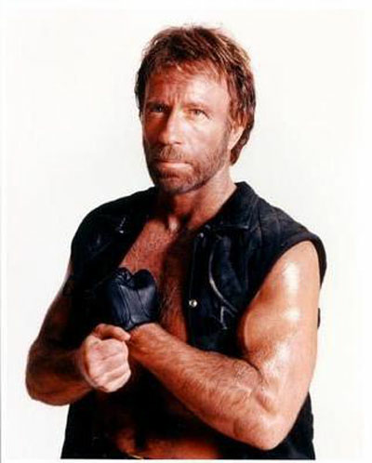
JSFiddle is great for prototyping but real men use Visual Studio
@keburnell ∙ DotNetDevDude.com
Notes:
Scrum most popular.

Slide 12
Bindings
@keburnell ∙ DotNetDevDude.com
Notes:
Scrum most popular.

Slide 13
Text and Appearance
text
html
visible
css
attr
style
@keburnell ∙ DotNetDevDude.com
Notes:
Scrum most popular.

Slide 14
Template
jQuery
Native KO
@keburnell ∙ DotNetDevDude.com
Notes:
Scrum most popular.

Slide 15
Control Flow
if
ifnot
with
foreach
@keburnell ∙ DotNetDevDude.com
Notes:
Scrum most popular.

Slide 16
Bindings
value
options
checked
click
event
enable
disable
selectedOptions
uniqueName
@keburnell ∙ DotNetDevDude.com
Notes:
Scrum most popular.

Slide 17
Parent Binding Contexts
@keburnell ∙ DotNetDevDude.com
Notes:
Scrum most popular.

Slide 18
Custom Bindings
@keburnell ∙ DotNetDevDude.com
Notes:
Scrum most popular.

Slide 19
Sample MVC App: Adding in the server
@keburnell ∙ DotNetDevDude.com
Notes:
Scrum most popular.

Slide 20

@keburnell ∙ DotNetDevDude.com
Notes:
Scrum most popular.

Slide 21
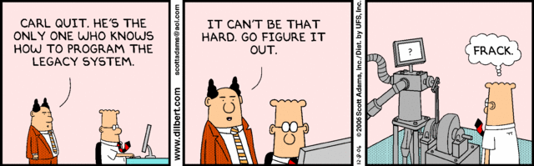
Ever inherit Legacy Code?
@keburnell ∙ DotNetDevDude.com
Notes:
Scrum most popular.

Slide 22

Ever scared to make changes?
@keburnell ∙ DotNetDevDude.com
Notes:
Scrum most popular.

Slide 23

If you answered yes to any of those questions
Then…
@keburnell ∙ DotNetDevDude.com
Notes:
Scrum most popular.

Slide 24

@keburnell ∙ DotNetDevDude.com
Notes:
Scrum most popular.

Slide 25
Types of testing that are not keys to test-driven development
@keburnell ∙ DotNetDevDude.com
Notes:
Scrum most popular.

Slide 26

Integration Testing
@keburnell ∙ DotNetDevDude.com
Notes:
Scrum most popular.

Slide 27
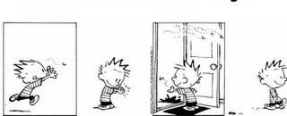
Regression Testing
@keburnell ∙ DotNetDevDude.com
Notes:
Scrum most popular.

Slide 28
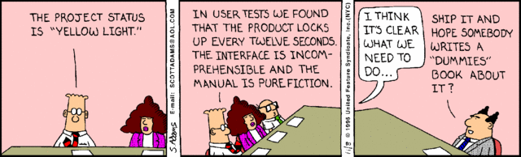
User Acceptance Testing (UAT)
@keburnell ∙ DotNetDevDude.com
Notes:
Scrum most popular.

Slide 29

Performance Testing
@keburnell ∙ DotNetDevDude.com
Notes:
Scrum most popular.

Slide 30

Load Testing
@keburnell ∙ DotNetDevDude.com
Notes:
Scrum most popular.

Slide 31
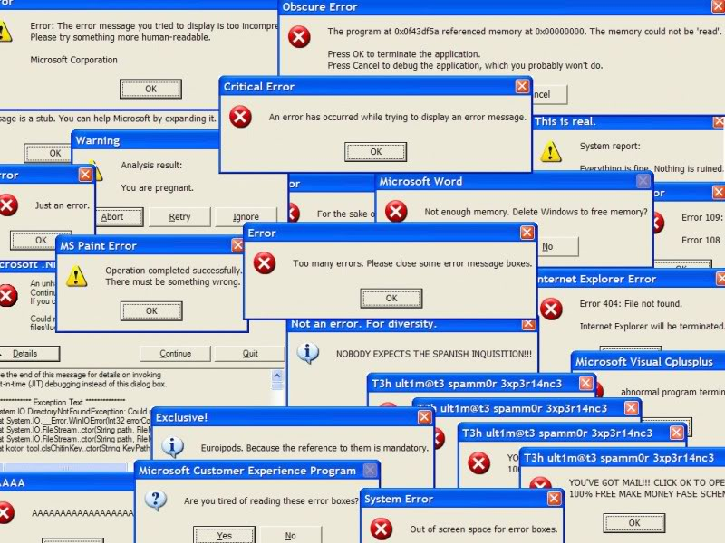
Stress Testing
@keburnell ∙ DotNetDevDude.com
Notes:
Scrum most popular.

Slide 32
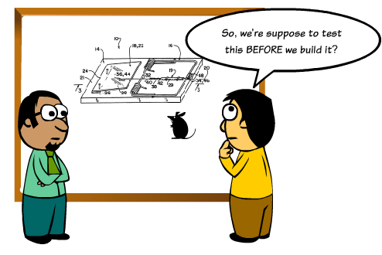
What is Test-driven Development?
@keburnell ∙ DotNetDevDude.com
Notes:
Scrum most popular.

Slide 33
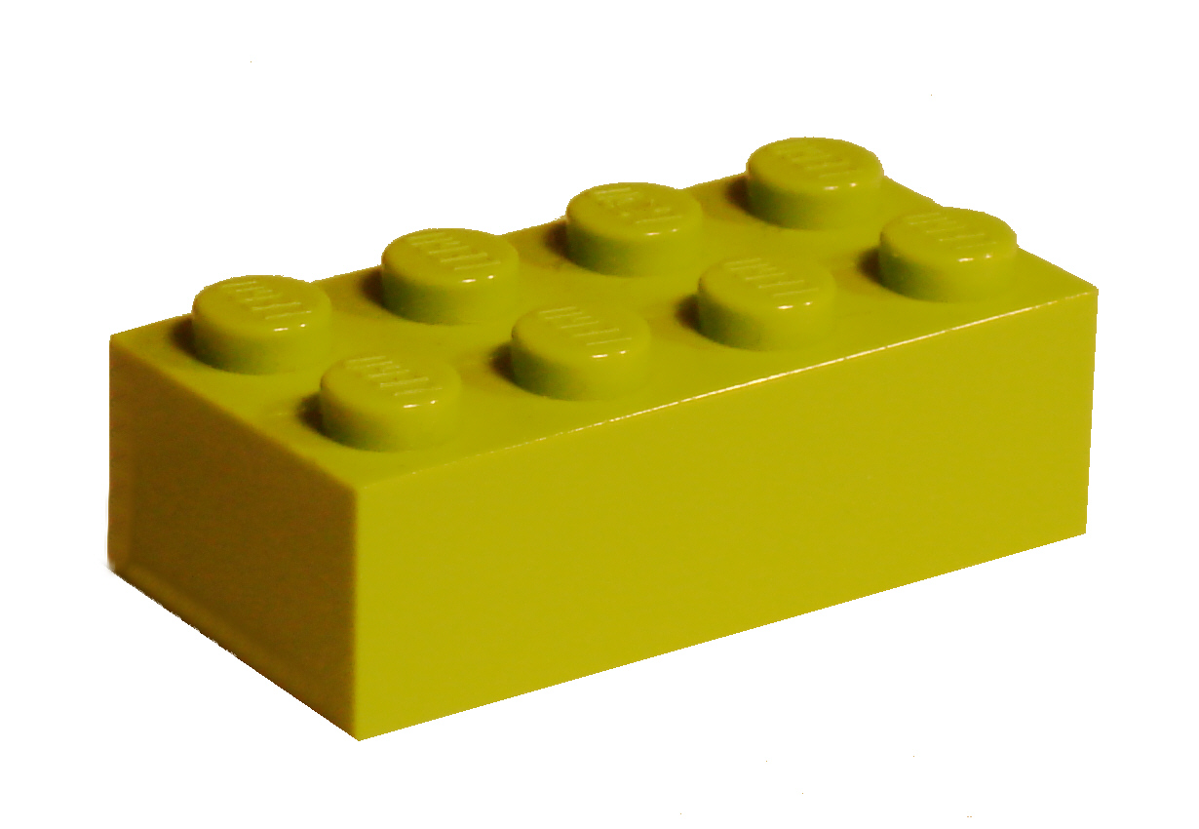
Unit Testing: Key to TDD
@keburnell ∙ DotNetDevDude.com
Notes:
Scrum most popular.

Slide 34

What makes a good Unit Test?
@keburnell ∙ DotNetDevDude.com
Notes:
Scrum most popular.

Slide 35

Automated and Repeatable
@keburnell ∙ DotNetDevDude.com
Notes:
Scrum most popular.

Slide 36
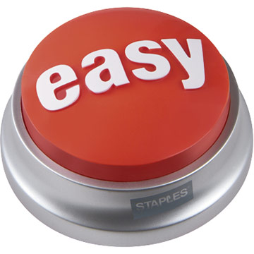
Easy to implement
@keburnell ∙ DotNetDevDude.com
Notes:
Scrum most popular.

Slide 37

Run on Demand at the Push of a Button
@keburnell ∙ DotNetDevDude.com
Notes:
Scrum most popular.

Slide 38

Fast
@keburnell ∙ DotNetDevDude.com
Notes:
Scrum most popular.

Slide 39

Isolated
@keburnell ∙ DotNetDevDude.com
Notes:
Scrum most popular.

Slide 40
Important Concepts & Strategies
@keburnell ∙ DotNetDevDude.com
Notes:
Scrum most popular.

Slide 41
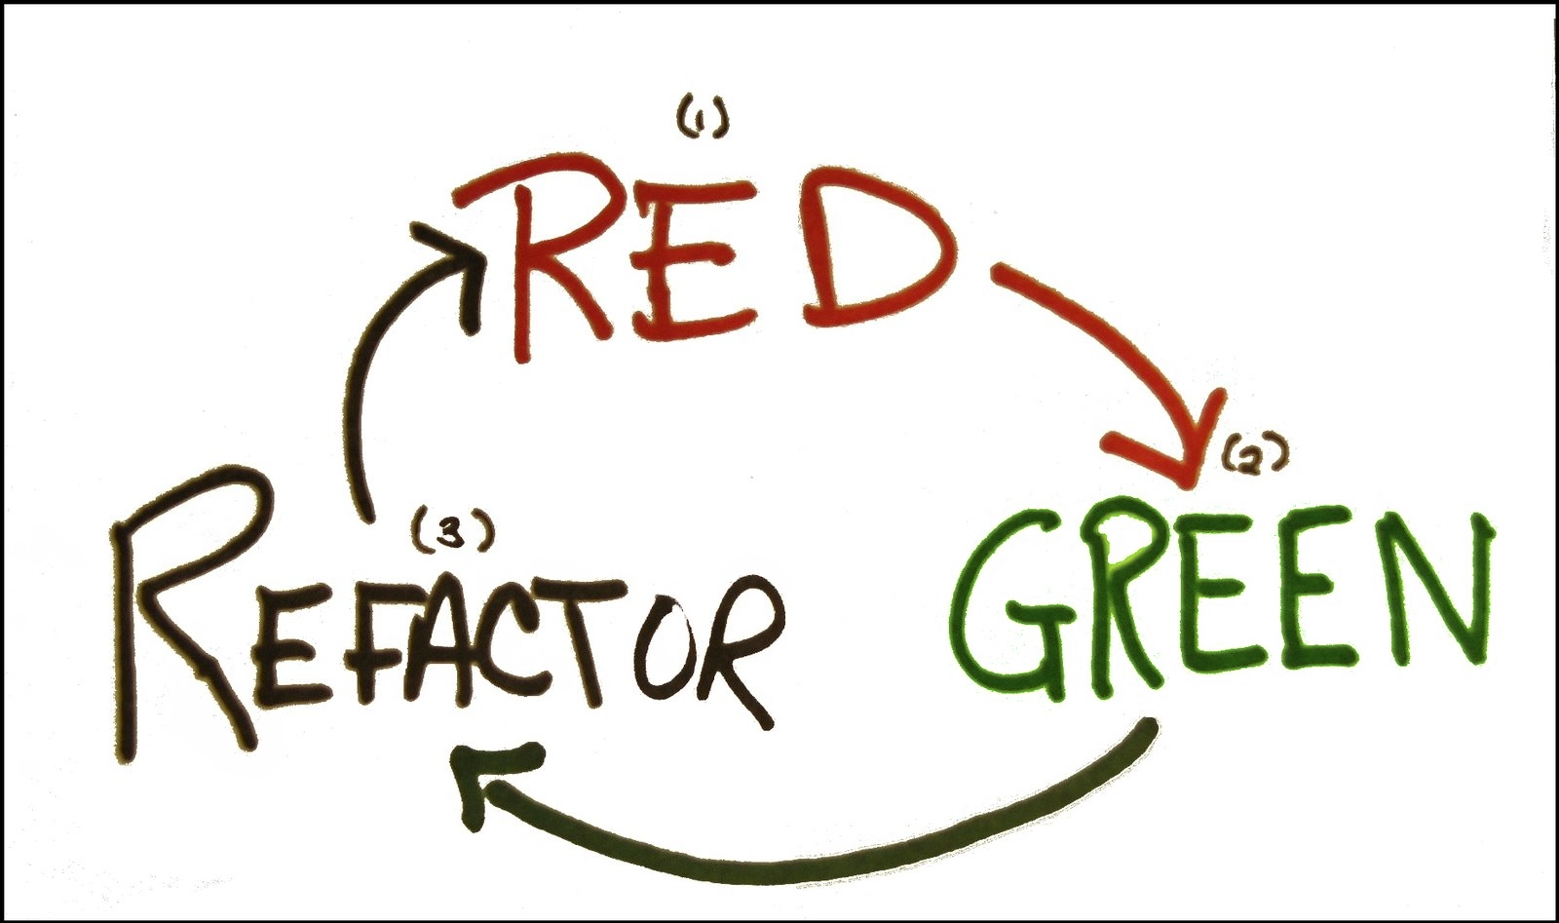
@keburnell ∙ DotNetDevDude.com
Notes:
Scrum most popular.

Slide 42

Arrange – Act - Assert
@keburnell ∙ DotNetDevDude.com
Notes:
Scrum most popular.

Slide 43
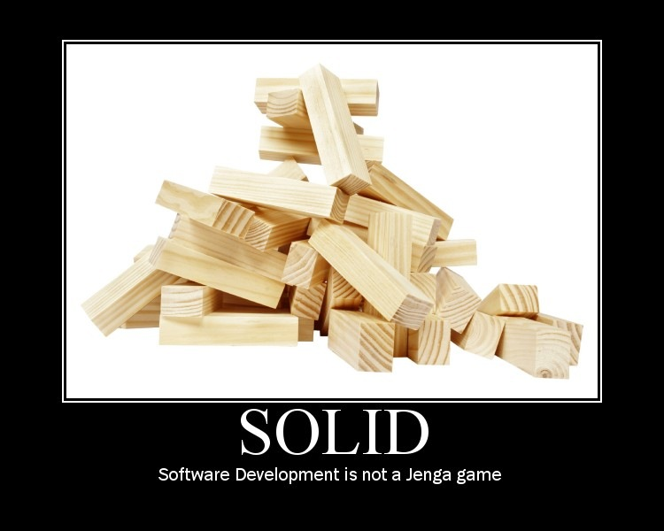
SOLID Principles of Software Development
@keburnell ∙ DotNetDevDude.com
Notes:
Scrum most popular.

Slide 44

Single Responsibility Principle
@keburnell ∙ DotNetDevDude.com
Notes:
Scrum most popular.

Slide 45

Open Closed Principle
@keburnell ∙ DotNetDevDude.com
Notes:
Scrum most popular.

Slide 46
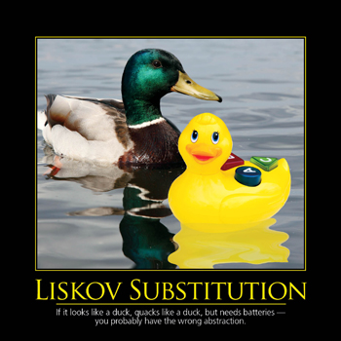
Liskov Substitution Principle
@keburnell ∙ DotNetDevDude.com
Notes:
Scrum most popular.

Slide 47

Interface Segregation Principle
@keburnell ∙ DotNetDevDude.com
Notes:
Scrum most popular.

Slide 48

Dependency Inversion Principle
@keburnell ∙ DotNetDevDude.com
Notes:
Scrum most popular.

Slide 49

Laying Out Your Solution For Unit Testing
@keburnell ∙ DotNetDevDude.com
Notes:
Scrum most popular.

Slide 50
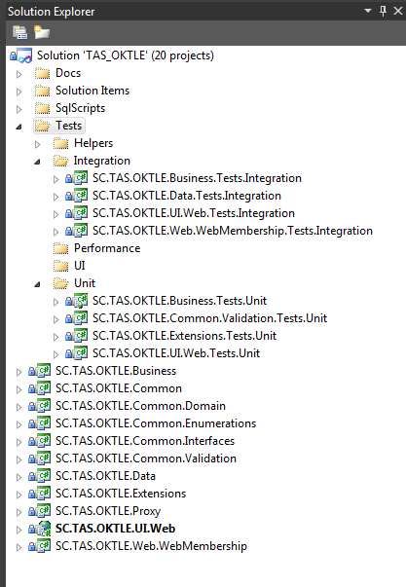
Example Solution Layout
@keburnell ∙ DotNetDevDude.com
Notes:
Scrum most popular.

Slide 51
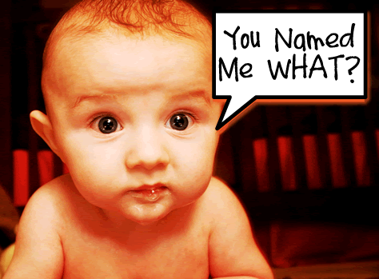
Naming Your Tests
@keburnell ∙ DotNetDevDude.com
Notes:
Scrum most popular.

Slide 52
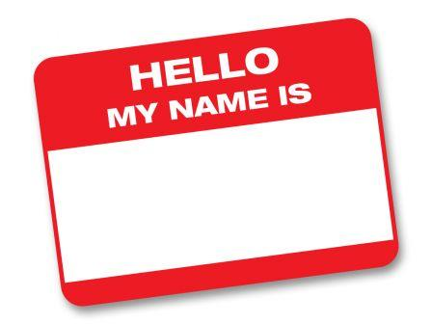
How I Name My Tests
[MethodUnderTest]_[ExpectedResult]_[Conditions]
GetCustomers_ShouldReturn_ListOf_Customers()
CalculateRate_ShouldReturn_25_When_Interest_Is_50_And_X_Is_5()
@keburnell ∙ DotNetDevDude.com
Notes:
Scrum most popular.

Slide 53
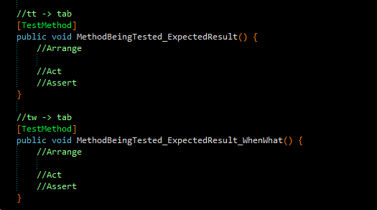
Resharper Live Template for Naming Tests
My unit testing live template is available on my blog:
http://www.dotnetdevdude.com/downloads/code/ ResharperUnitTestTemplates.zip
@keburnell ∙ DotNetDevDude.com
Notes:
Scrum most popular.

Slide 54

Let’s Write Our First Unit Test - Together!
@keburnell ∙ DotNetDevDude.com
Notes:
Scrum most popular.

Slide 55
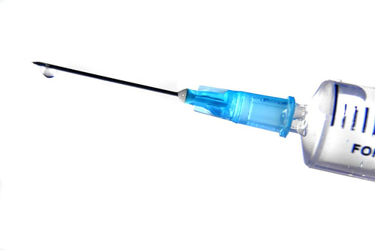
Dependency Injection (DI)
@keburnell ∙ DotNetDevDude.com
Notes:
Scrum most popular.

Slide 56

Inversion of Control (IoC)
@keburnell ∙ DotNetDevDude.com
Notes:
Scrum most popular.

Slide 57

Non-programming Example of IoC
Simple Scenario: Your having a bathroom remodeled
Remodel Bathroom: $10,000.00
@keburnell ∙ DotNetDevDude.com
Notes:
Scrum most popular.

Slide 58

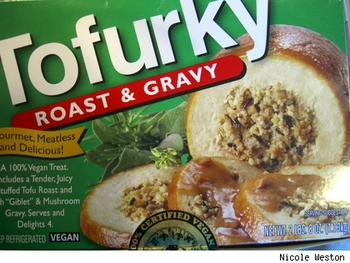
What does implementing DI/IoC get me?
Separation of Concerns
Mockability (we will get to this)
@keburnell ∙ DotNetDevDude.com
Notes:
Scrum most popular.

Slide 59
Let’s Do Some DI/IoC - Together!
@keburnell ∙ DotNetDevDude.com
Notes:
Scrum most popular.

Slide 60

Ruh roh! Test is broken!
@keburnell ∙ DotNetDevDude.com
Notes:
Scrum most popular.

Slide 61
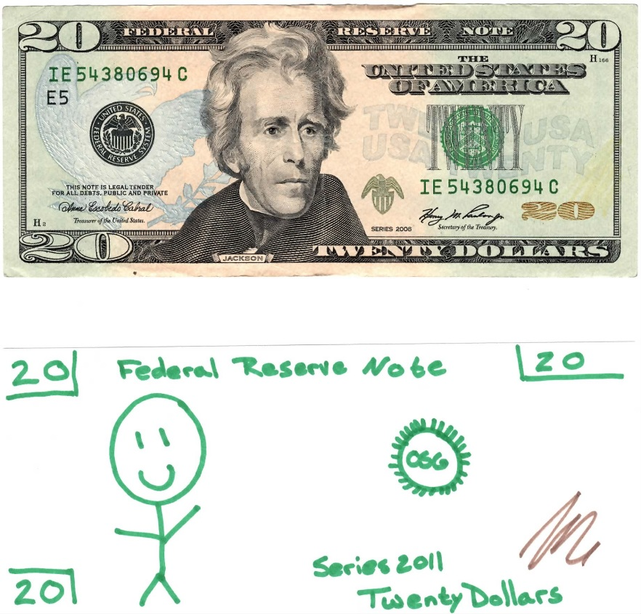
Fakes/Stubs
@keburnell ∙ DotNetDevDude.com
Notes:
Scrum most popular.

Slide 62

Mocks
@keburnell ∙ DotNetDevDude.com
Notes:
Scrum most popular.

Slide 63

Dependency Injection 101
@keburnell ∙ DotNetDevDude.com
Notes:
Scrum most popular.

Slide 64

DI/IoC Tooling
@keburnell ∙ DotNetDevDude.com
Notes:
Scrum most popular.

Slide 65
Lots of Available Tooling
For a list of the most common and a sample application that implements each one check a blog post I did;
http://bit.ly/hnIjlu
@keburnell ∙ DotNetDevDude.com
Notes:
Scrum most popular.

Slide 66
Let’s Implement DI/IoC with Tooling - Together!
@keburnell ∙ DotNetDevDude.com
Notes:
Scrum most popular.

Slide 67

Slides, Code, and Notes On GitHub
http://www.github.com/kburnell/TestDriving.NET
@keburnell ∙ DotNetDevDude.com
Notes:
Scrum most popular.

Slide 68
Other Resources
Test Driven Development: By Example (Kent Beck)
The Art of Unit Testing (Roy Osherove)
Roy Osherove’s Blog (http://www.osherove.com)
TypeMock’s website (http://www.typemock.com)
My Website (http://www.dotnetdevdude.com)
@keburnell ∙ DotNetDevDude.com
Notes:
Scrum most popular.

Slide 69
Tools I Used and/or Talked About
NuGet (http://www.nuget.org)
ReSharper (http://www.jetbrains.com/resharper/)
Should Assertion Library (http://should.codeplex.com)
NCrunch (http://www.ncrunch.net)
RhinoMocks (http://hibernatingrhinos.com/open-source/rhino-mocks
StructureMap (http://www.structuremap.net)
@keburnell ∙ DotNetDevDude.com
Notes:
Scrum most popular.

Slide 70
Friday April 27th (all day)
Radisson Paper Valley Hotel (Appleton, WI)
Led by Clark Sell and Brian Prince
Hands on deep dive
Free
Lunch will be provided
Bring your own hardware
Register Now!
http://www.BootCamp.fvnug.org
@keburnell ∙ DotNetDevDude.com
Notes:
Scrum most popular.

Slide 71
Saturday April 28th (8:00 – 4:30)
Fox Valley Tech Commons area
Great speakers and content
Free
Lunch will be provided
Lots of Swag!
All attendees will get a free eBook from O’Reilly
Register Now!
http://www.DayOfDotNet.fvnug.org
@keburnell ∙ DotNetDevDude.com
Notes:
Scrum most popular.

Slide 72

@keburnell ∙ DotNetDevDude.com
Notes:
Scrum most popular.

Slide 73
Thank You!
Questions?
Twitter: @keburnell
Blog: DotNetDevDude.com
Email: keith@DotNetDevDude.com
@keburnell ∙ DotNetDevDude.com
Notes:
Scrum most popular.

